Slide 1
Creating an Effective Visual

Slide 2

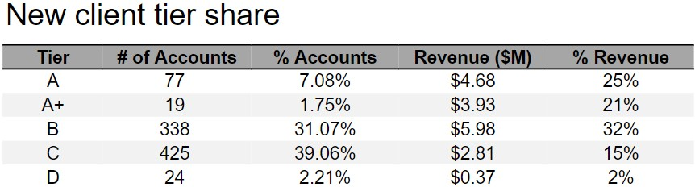
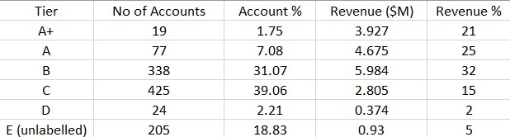
1 . What observations can you make?
Data gives information about revenue generated from each tier which is a basket of stocks account holder invested upon.
Only A and A+ (Premium) tier accounts corresponds to half of the revenue(46%) which gives the confirmation that tier A
A+ has the best performing stocks.
Besides large number of accounts ,Tier C is generating low revenue and tier D has the least performing stocks.
2. Do you have to make any assumptions when interpreting this data?
Assuming remaining missing accounts as a Single Unlabeled Tier "E" and calculating the remaining Revenue % & Number of Accounts in that tier.
3. What questions do you have about this data?
How are the tiers named and classified? Is it based on revenue generated ?
Why is the revenue percentage not summing to 100? What are the other ways of revenue generation?

Slide 3
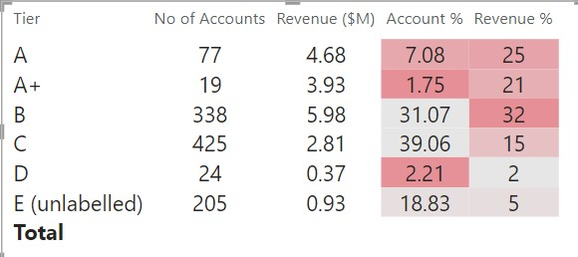
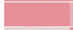
Improved Table
Highest revenue & Lowest Account %

Slide 4
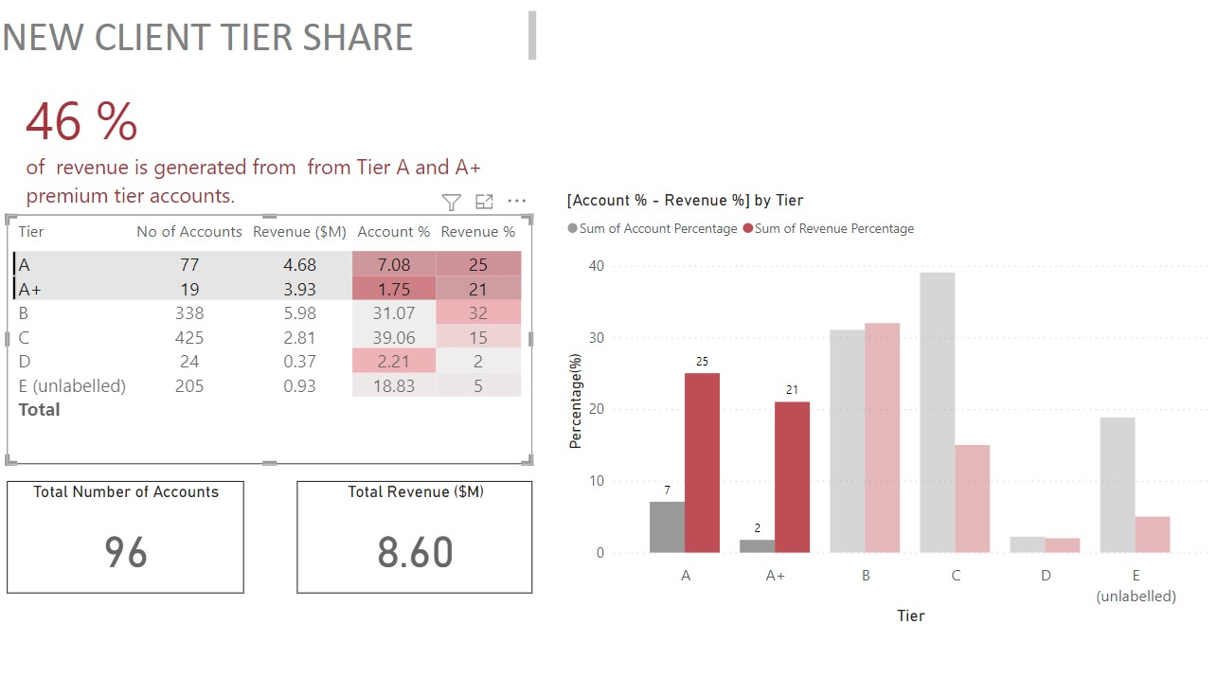
Visualization of Data using Clustered Column Chart

Slide 5

THANKYOU

